Slide 1
COSP230 Ch. 6
Splash Screens and Audio Files

Slide 2
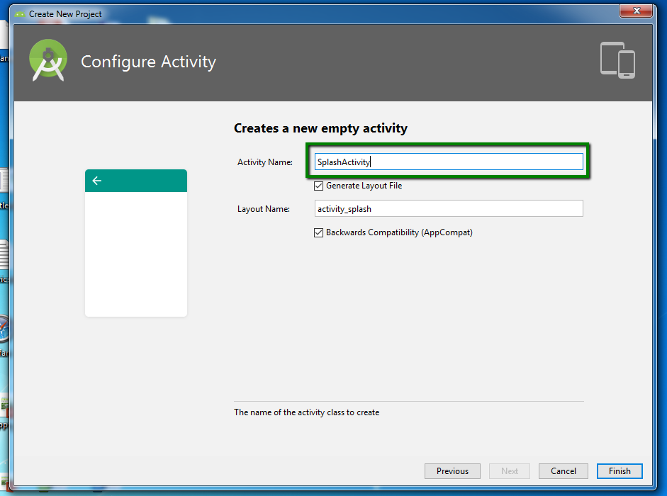
Create Aloha Music Project
When you get to the Configure Activity window, replace MainActivity with SplashActivity.
Everything else in this process stays the same.

Slide 3
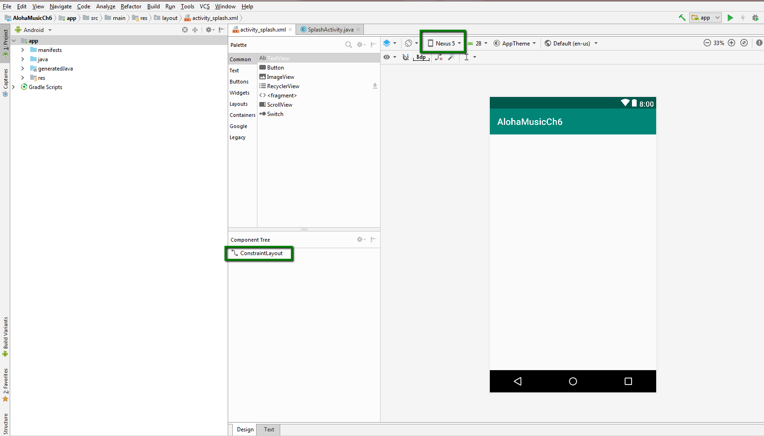
Start of Project (Delete HelloWorld text, select Nexus 5, keep as Constraint Layout):

Slide 4
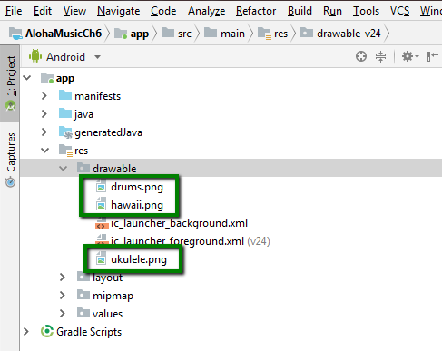
Add graphic files to drawable folder
Download the image files from the Ch 6 Images folder in Files and save to Desktop
Copy and paste the files in the green boxes into the drawable folder

Slide 5
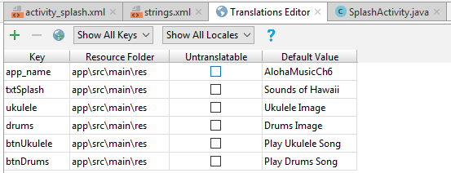
Add keys in Translations Editor
Open the Translations Editor
Add the keys in the table on the right:

Slide 6
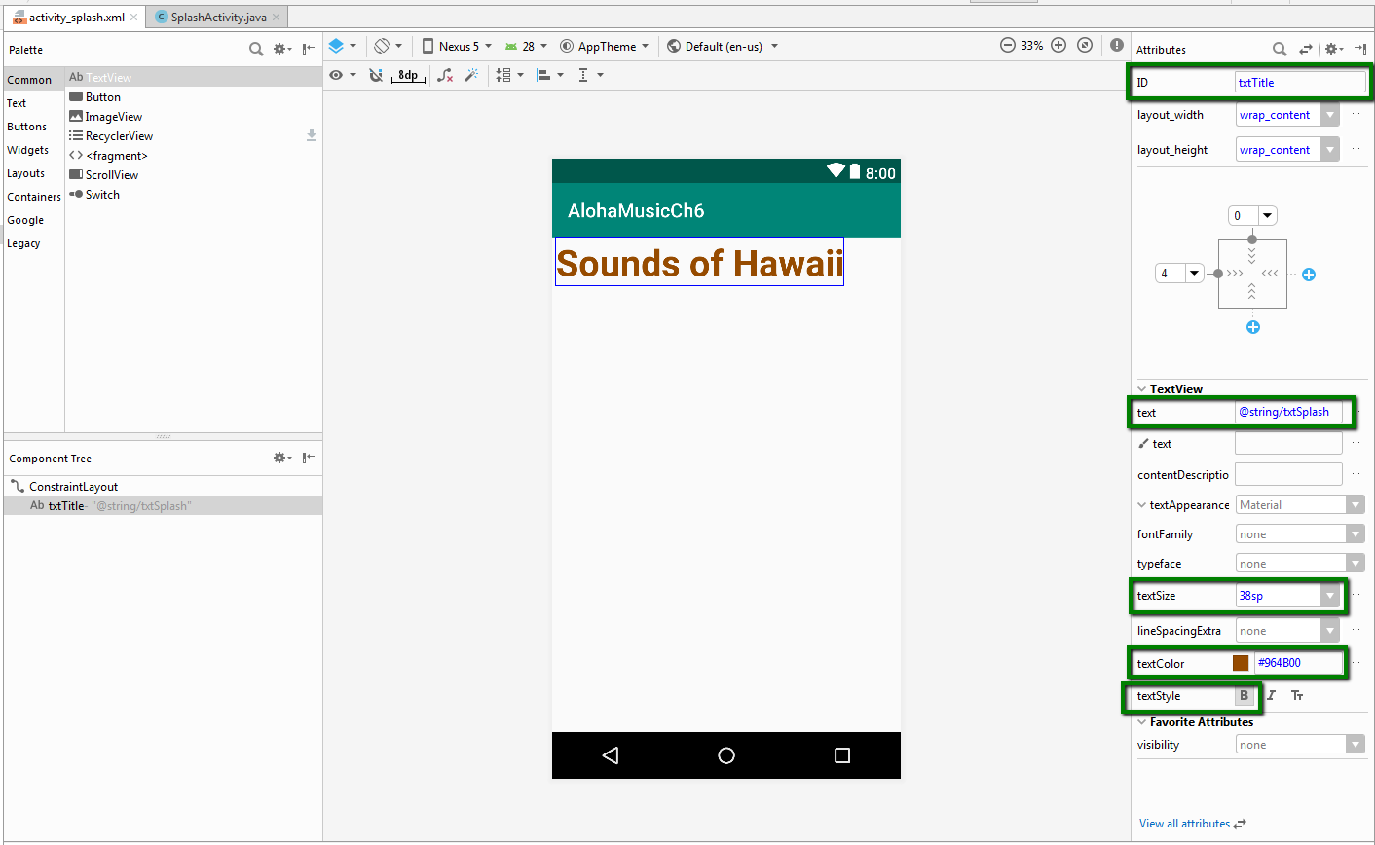
Add a TextView widget
Drag and drop a TextView widget to the top left of the screen
If you are in a Constraint Layout, don’t forget the “magic wand” button
Enter the attributes highlighted by boxes in the picture on the right
But wait…there’s more…

Slide 7
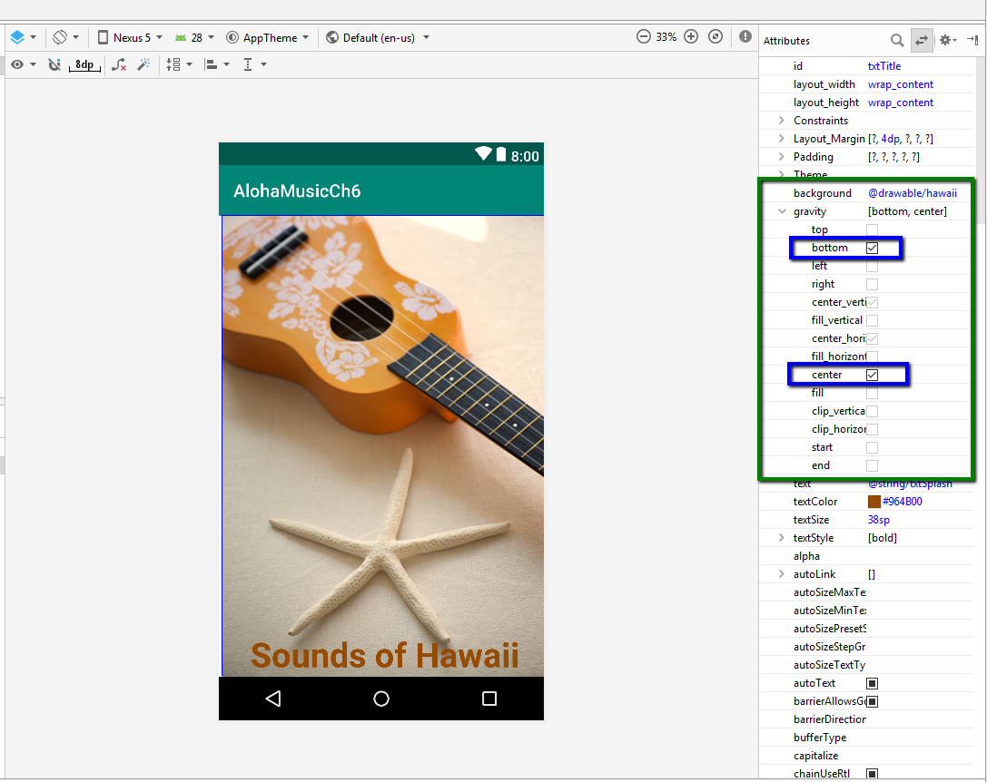
Background and Gravity attributes
Change background attribute to display hawaii.png image
Change Gravity attribute so text box is in bottom and center of emulator
Image should appear as shown

Slide 8
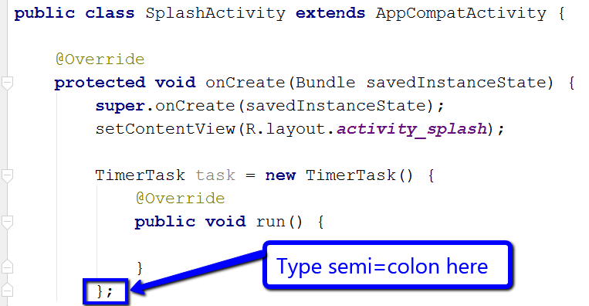
Update SplashActivity.java with TimerTask
In SplashActivity.java, do the following:
After setContentView(), create an object of the TimerTask class as shown
You may have to use Alt+Enter to import the proper class
Some code will automatically appear
You might need to type a semi-colon where shown

Slide 9
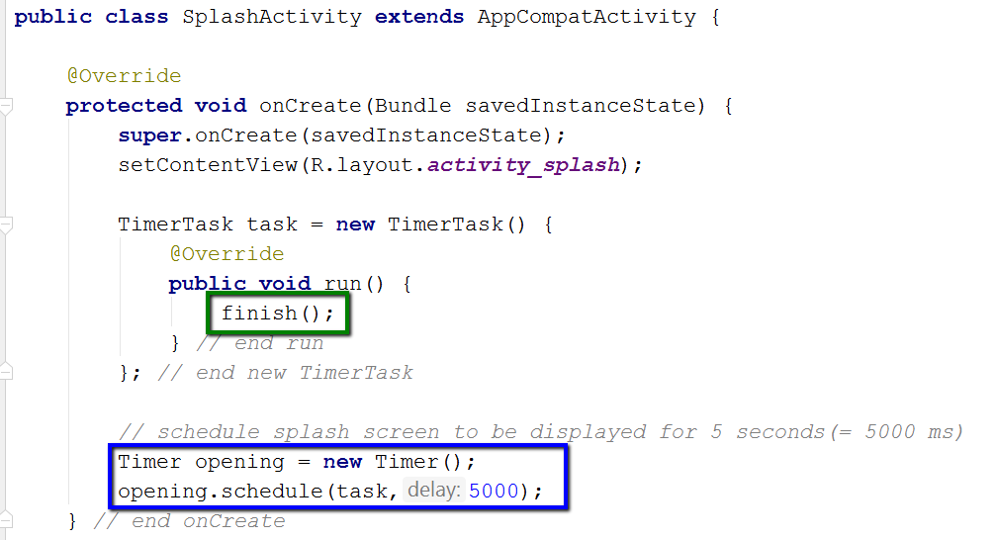
Set time and add finish() method
Create method of class time called opening.
Two parameters
task – TimerTask object
5000 – time in milliseconds
finish() method
Part of onDestroy() method that ends task and frees memory.
Called from within run() method

Slide 10
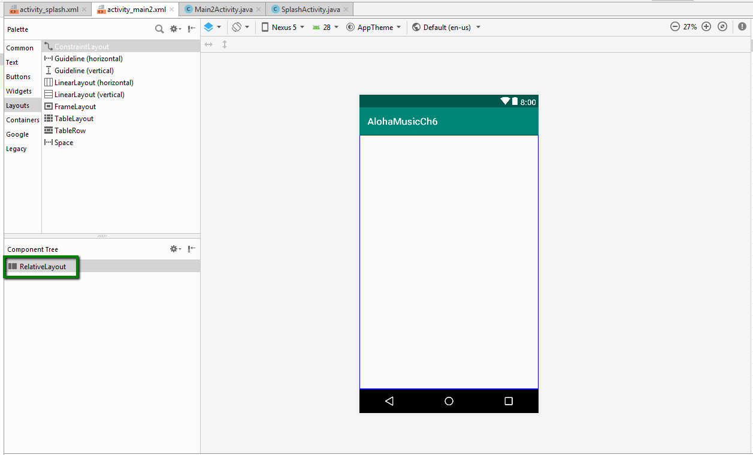
Create MainActivity (Delete HelloWorld text, select Nexus 5, convert to Relative Layout):

Slide 11
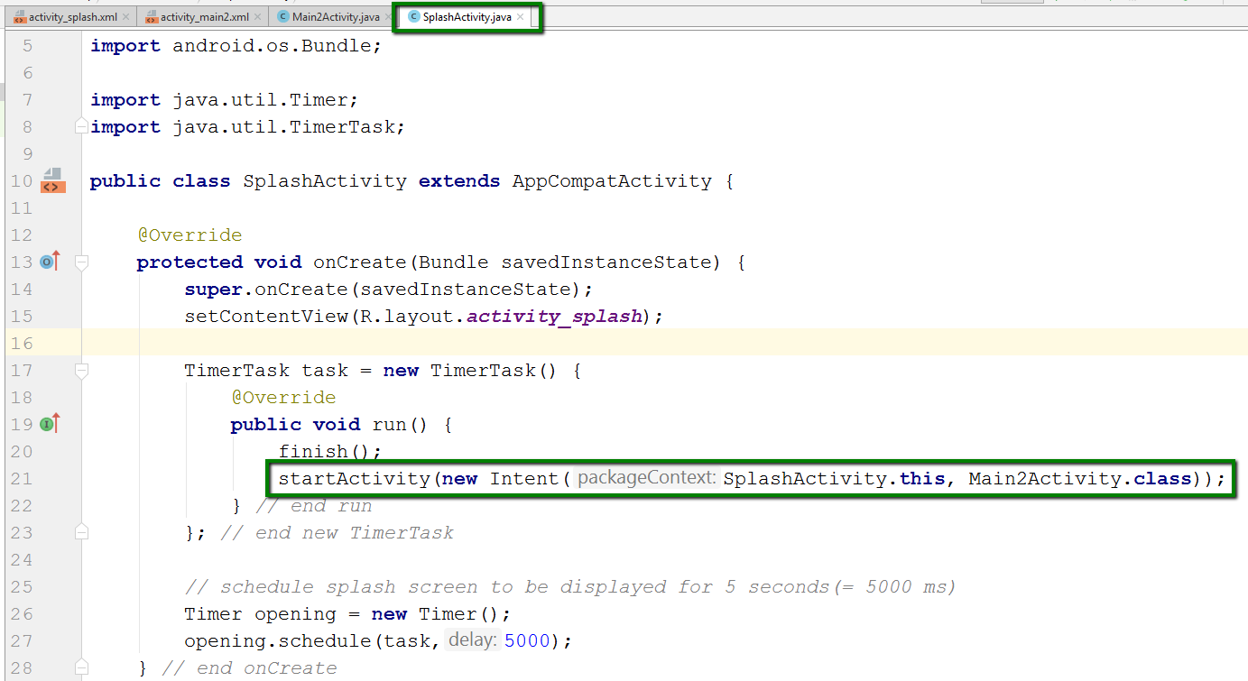
Update SplashActivity.java again
Add the line of code in the green box to ensure new activity is displayed after splash screen times out.
NOTE: I made a mistake and had to re-create my main activity. That’s why it says Main2Activity. Yours should just say MainActivity.

Slide 12
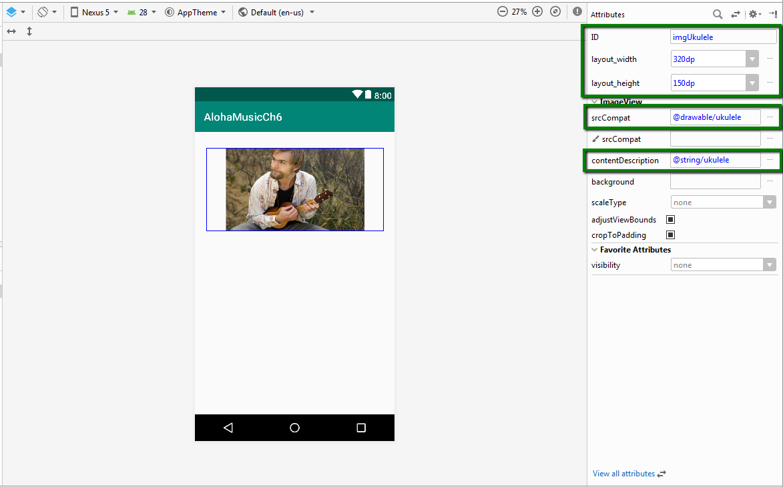
Add Ukulele in an ImageView
Drag and drop an ImageView widget into the upper third of the emulator.
Change the attributes shown in the boxes on the right.
If needed, change Layout_Margin property to 20dp on the top

Slide 13
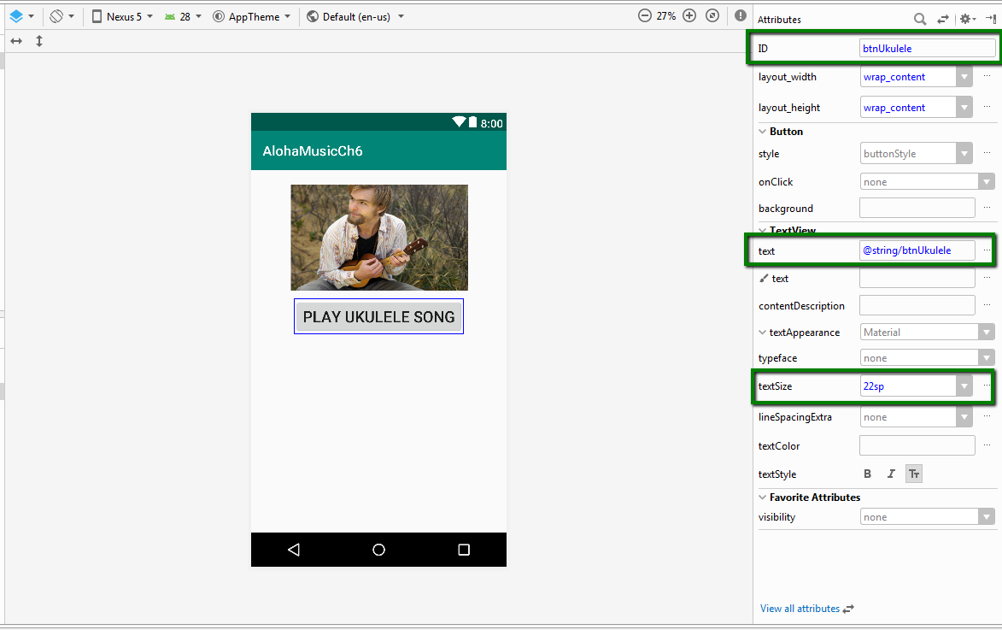
Add a Button for ukulele
Drag and drop a button into the emulator
Change the attributes in the boxes as shown on the right.

Slide 14
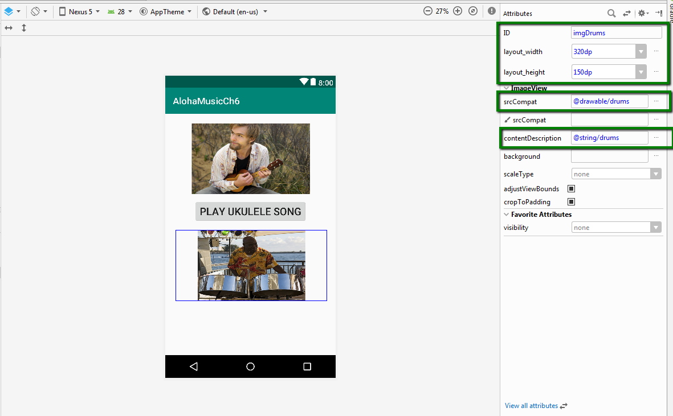
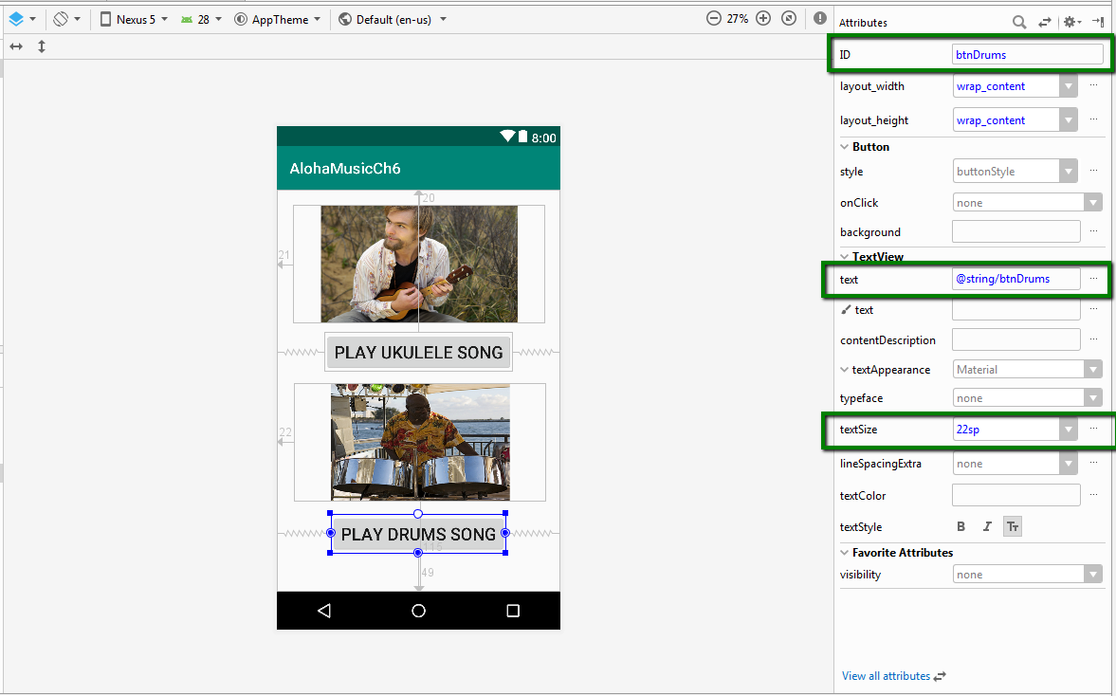
Add image and button for Drums as shown:

Slide 15
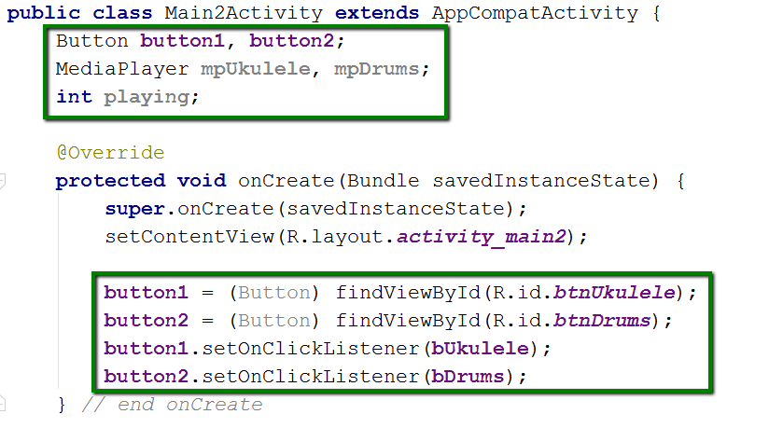
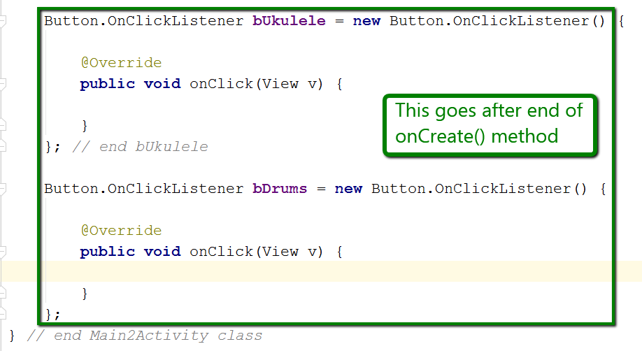
Add the following code to MainActivity.java

Slide 16
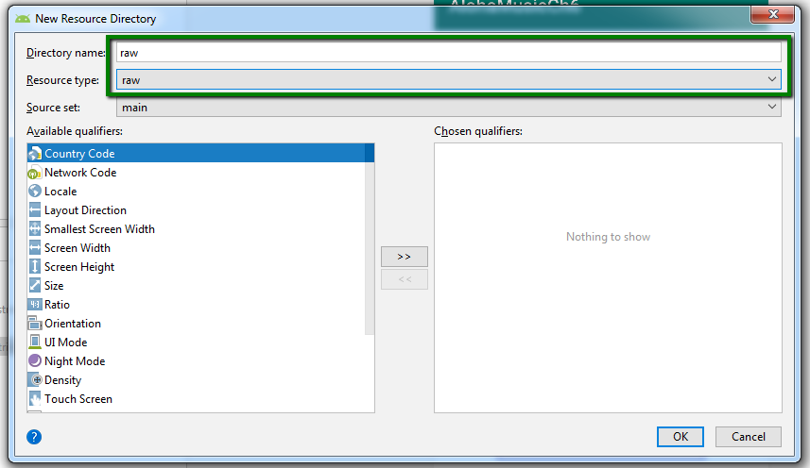
Create raw directory for audio files
In Project View, right click on res folder.
In menu, select the following:
New->Android Resource Directory
In New Resource Directory window, do the following
Type raw in Directory name field
Select raw from drop-down menu in Resource type field
Click OK

Slide 17
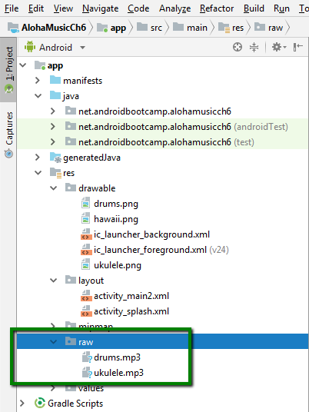
Copy and paste audio files to raw folder
Copy each folder
Right click raw folder and select Paste

Slide 18
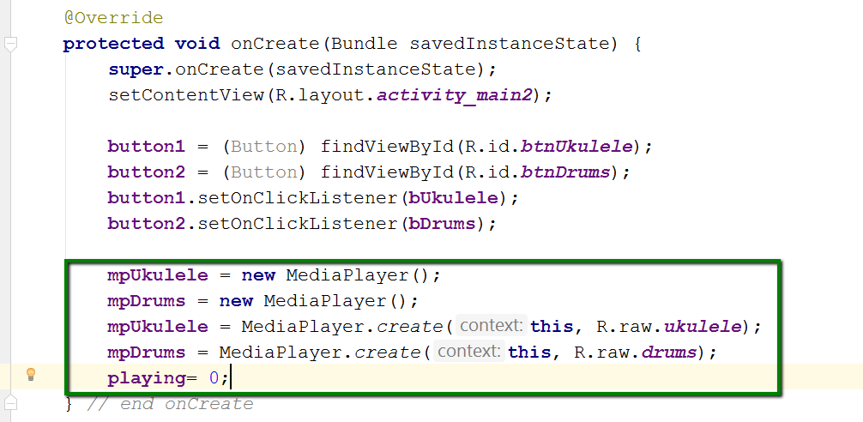
Create MediaPlayer objects in onCreate()
Two objects are created, one for each audio file
The create method is used to associate each object with the correct audio file from the raw folder
Set variable playing to 0.
This will be used to indicate which button was clicked.

Slide 19
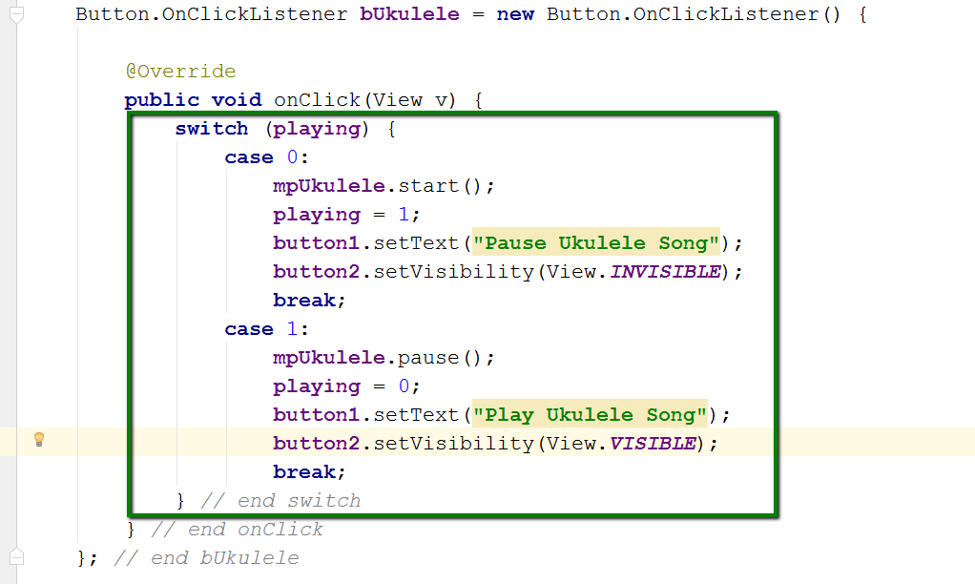
Add code for Ukulele button
Media player object has three states:
start()
pause()
stop()
setText()
Used to change text for button, just like a TextView
setVisibility() – makes button visible (can select) or invisible (cannot select)

Slide 20
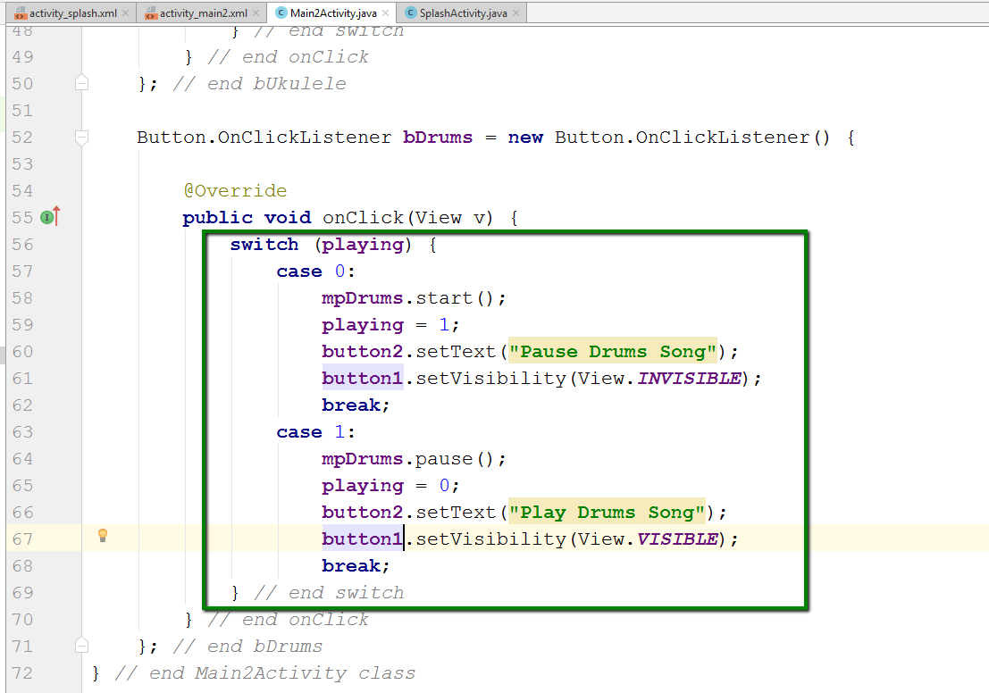
Add code for Drums button
Media player object has three states:
start()
pause()
stop()
setText()
Used to change text for button, just like a TextView
setVisibility() – makes button visible (can select) or invisible (cannot select)

Slide 21
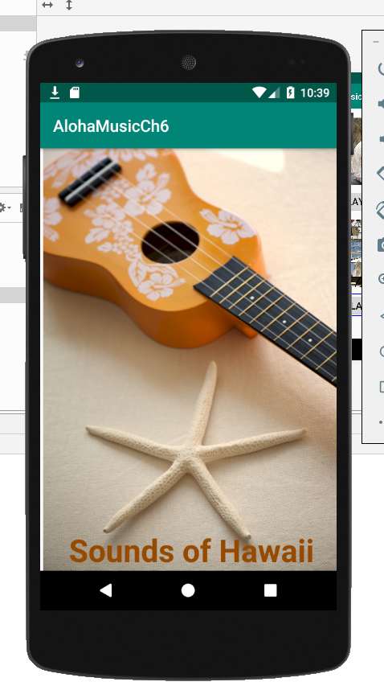
Run the app. You should get this (for 5 seconds):

Slide 22
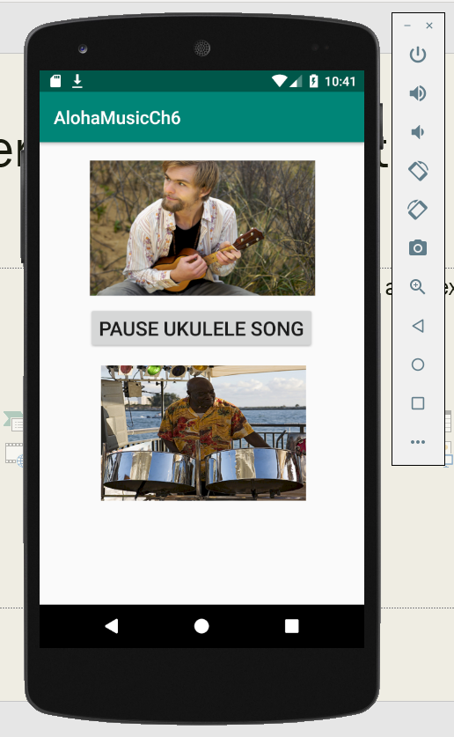
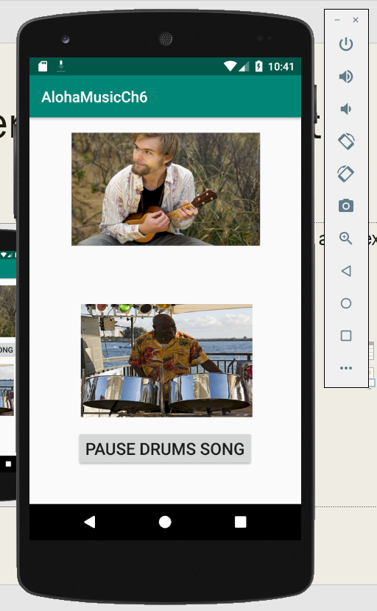
Click either button to hear the music:

